Slide 1








IBM Capstone Basic
Julio Diaz Delgado
22/07/22
This is not the final version but i could not do better in the shorter spawn that i got before my subscription ends i hope you enjoy the reading

Slide 2


OUTLINE
• Executive Summary
• Introduction
• Methodology
• Results
• Conclusion
• Appendix

Slide 3

EXECUTIVE SUMMARY
• Summary of methodologies - Data Collection through API - Data Collection with Web Scraping - Data Wrangling - Exploratory Data Analysis with SQL - Exploratory Data Analysis with Data
• Visualization - Interactive Visual Analytics with Folium - Machine Learning Prediction
• Summary of all results - Exploratory Data Analysis result - Interactive analytics in screenshots - Predictive Analytics result

Slide 4

INTRODUCTION
Project background and context Space X advertises Falcon 9 rocket launches on its website with a cost of 62 million dollars; other providers cost upward of 165 million dollars each, much of the savings is because Space X can reuse the first stage. Therefore, if we can determine if the first stage will land, we can determine the cost of a launch. This information can be used if an alternate company wants to bid against space X for a rocket launch. This goal of the project is to create a machine learning pipeline to predict if the first stage will land successfully
Problems you want to find answers - What factors determine if the rocket will land successfully? - The interaction amongst various features that determine the success rate of a successful landing. - What operating conditions needs to be in place to ensure a successful landing program.

Slide 5

METHODOLOGY
Executive Summary
• Data collection methodology: • Data was collected using SpaceX API and web scraping from Wikipedia • Perform data wrangling • One-hot encoding was applied to categorical features • Perform exploratory data analysis (EDA) using visualization and SQL • Perform interactive visual analytics using Folium and Plotly Dash • Perform predictive analysis using classification models • How to build, tune, evaluate classification models

Slide 6
Data Collection
• The data was collected using various methods - Data collection was done using get request to the SpaceX API. - Next, we decoded the response content as a Json using .json() function call and turn it into a pandas dataframe using .json_normalize(). - We then cleaned the data, checked for missing values and fill in missing values where necessary. - In addition, we performed web scraping from Wikipedia for Falcon 9 launch records with BeautifulSoup. - The objective was to extract the launch records as HTML table, parse the table and convert it to a pandas dataframe for future analysis.
This is the permalink to the data.
https://github.com/kylekk76/IBM-Data-Science/blob/9639f0a8049ac9ff53977186bdfc87104d63609c/capstone%20in%20progress/spacex-data-collection.ipynb

Slide 7
Data Wrangling
Performed exploratory data analysis and determined the training labels.
Calculated the number of launches at each site, and the number and occurrence of each orbits
Created landing outcome label from outcome column and exported the results to csv.
This is the link to the Notebook and rest of the work:
https://github.com/kylekk76/IBM-Data-Science/blob/9639f0a8049ac9ff53977186bdfc87104d63609c/capstone%20in%20progress/Spacex-Data%20wrangling.ipynb

Slide 8
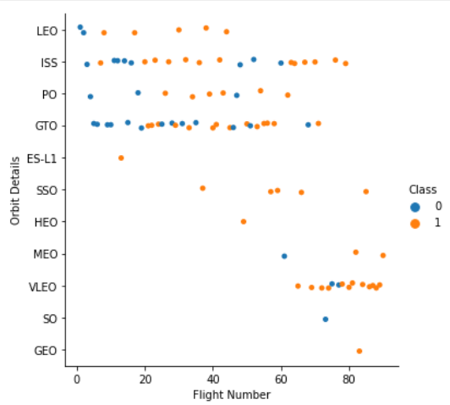
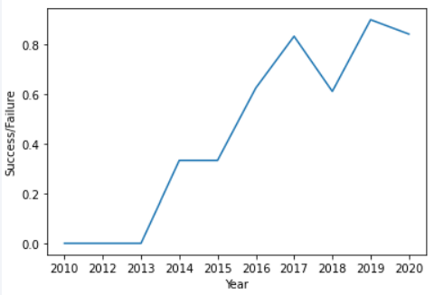
EDA- With Data Visualization
Explored the data by visualizing the relationship between flight number and launch Site, payload and launch site, success rate of each orbit type, flight number and orbit type, the launch success yearly trend.
The Link To the Repository is:
https://github.com/kylekk76/IBM-Data-Science/blob/9639f0a8049ac9ff53977186bdfc87104d63609c/capstone%20in%20progress/Exploratory_Data_Base_Visualization.ipynb

Slide 9
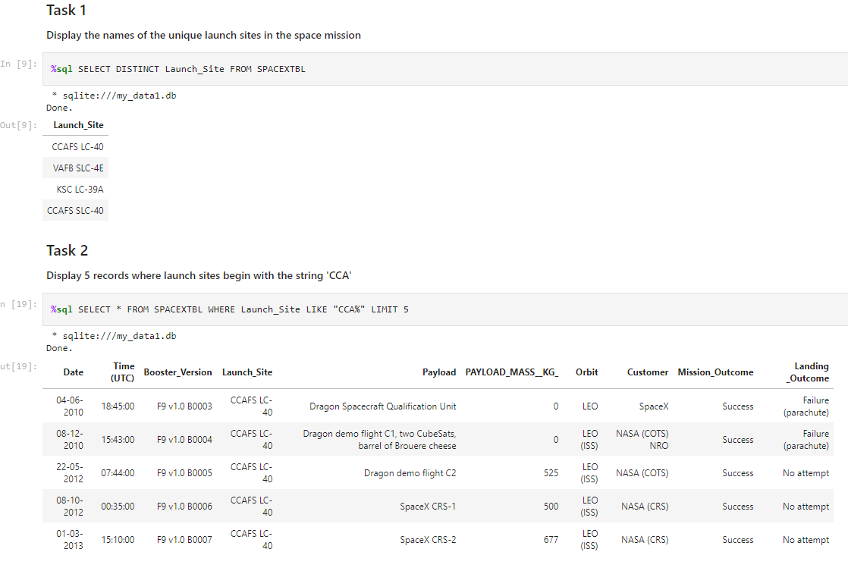
EDA With SQL
Loaded sample SpaceX dataset into a PostgreSQL database.
Applied EDA with SQL to get insight from the data. Wrote queries to find out for instance: The names of unique launch sites in the space mission.
The permalink to the Notebook:
https://github.com/kylekk76/IBM-Data-Science/blob/9639f0a8049ac9ff53977186bdfc87104d63609c/capstone%20in%20progress/Exploratory_Data_Base_With_SQL.ipynb

Slide 10
Interactive Map with Folium
Marked all launch sites, and added map objects such as markers, circles, lines to mark the success or failure of launches for each site on the folium map.
Assigned the feature launch outcomes (failure or success) to class 0 and 1.i.e., 0 for failure, and 1 for success.
Using the color-labeled marker clusters, identified which launch sites have relatively high success rate.
Calculated the distances between a launch site to its proximities. Answered some question for instance: - Are launch sites near railways, highways and coastlines. - Do launch sites keep certain distance away from cities.
This is the permalink if you wanna give a check:
https://github.com/kylekk76/IBM-Data-Science/blob/9639f0a8049ac9ff53977186bdfc87104d63609c/capstone%20in%20progress/Launch%20sites%20location.ipynb

Slide 11
Dashboard with Plotly Dash
Built an interactive dashboard with Plotly dash
Plotted pie charts showing the total launches by a certain sites
Plotted scatter graph showing the relationship with Outcome and Payload Mass (Kg) for the different booster version.
Permalink:
https://github.com/kylekk76/IBM-Data-Science/blob/9639f0a8049ac9ff53977186bdfc87104d63609c/capstone%20in%20progress/spacex_dash_app.py

Slide 12
Predictive Analysis (Classification)
Loaded the data using numpy and pandas, transformed the data, split our data into training and testing.
Built different machine learning models and tune different hyperparameters using GridSearchCV.
Used accuracy as the metric for our model, improved the model using feature engineering and algorithm tuning.
Found the best performing classification model.
Permalink:
https://github.com/kylekk76/IBM-Data-Science/blob/9788f7501cfb320fa3f5b3eac1e79b37c419b78c/capstone%20in%20progress/SpaceX_Machine%20Learning%20Prediction_Part_5.ipynb

Slide 13
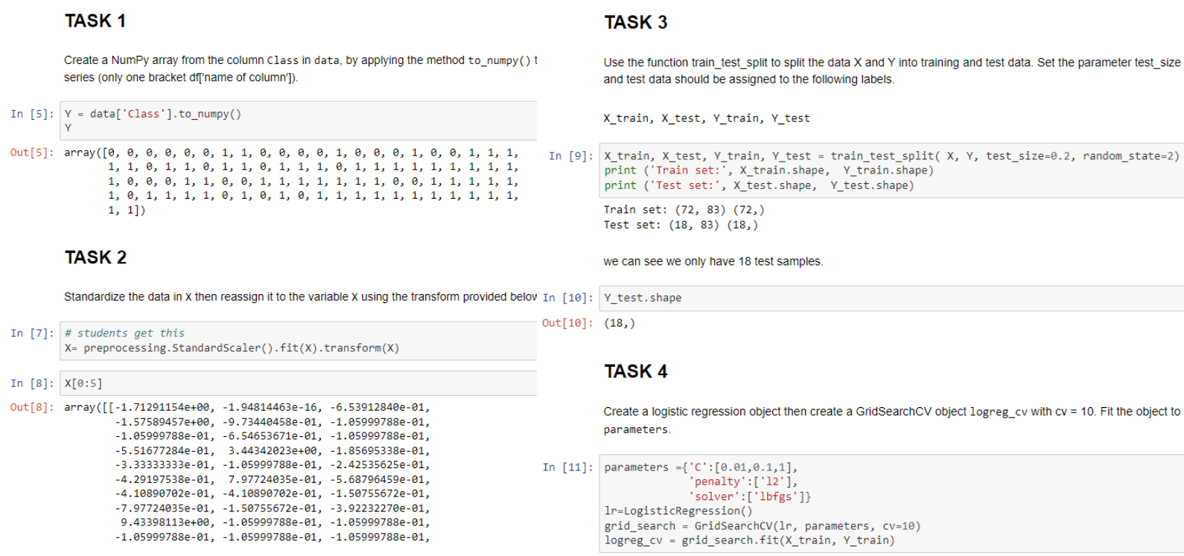
Predictive Analysis (Classification)
Haga clic para agregar texto
Haga clic para agregar texto

Slide 14
RESULTS
• Exploratory data analysis results
• Interactive analytics demo in screenshots
• Predictive analysis results

Slide 15
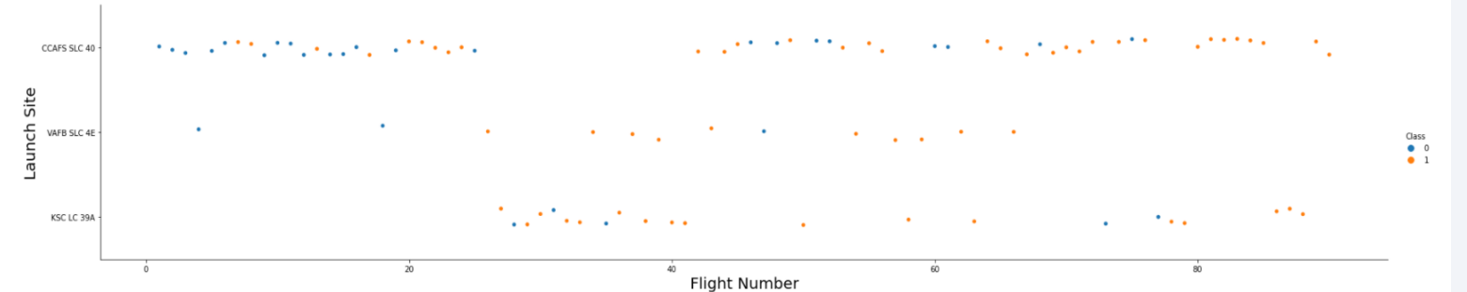
Flight Number vs. Launch Site
From the plot, we found that the larger the flight amount at a launch site, the greater the success rate at a launch site.

Slide 16
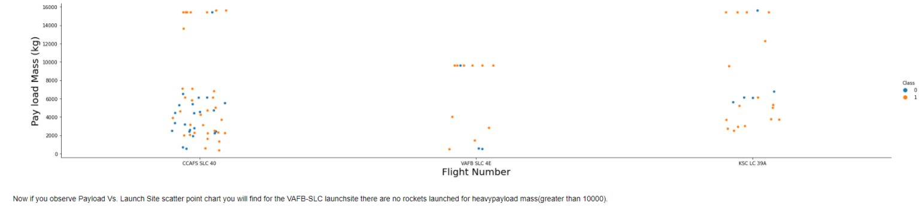
Payload vs. Launch Site
If we observe Payload Vs. Launch Site scatter point chart you will find for the VAFBSLC launchsite there are no rockets launched for heavypayload mass(greater than 10000)

Slide 17
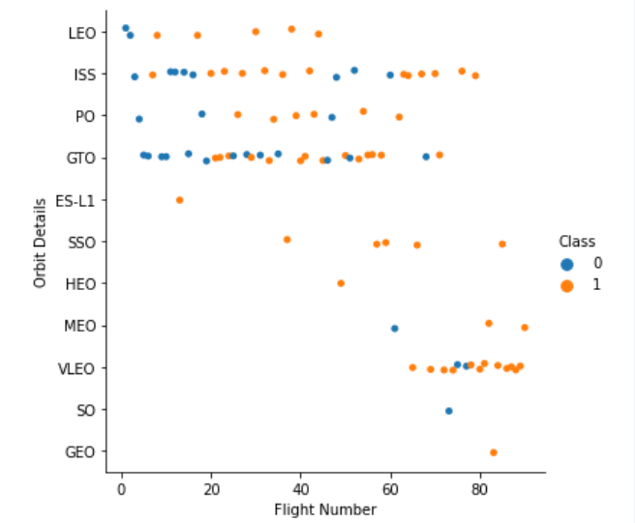
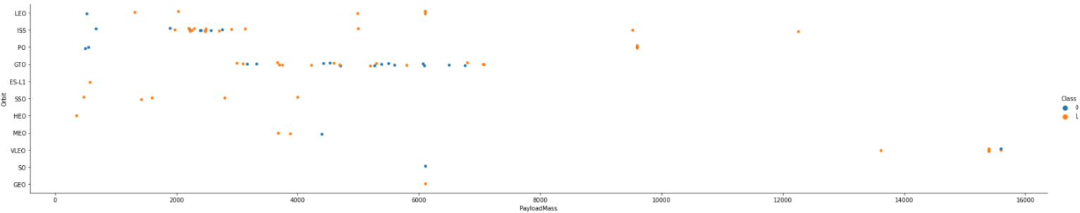
Success Rate vs. Orbit Type Flight Number vs. Orbit Type Payload vs. Orbit Type
From the plot, we can see that ES-L1, GEO, HEO, SSO had the most success rate.
The plot below shows the Flight Number vs. Orbit type. We observe that in the LEO orbit, success is related to the number of flights whereas in the GTO orbit, there is no relationship between flight number and the orbit.
We can observe that with heavy payloads, the successful landing are more for PO, LEO and ISS orbits.

Slide 18
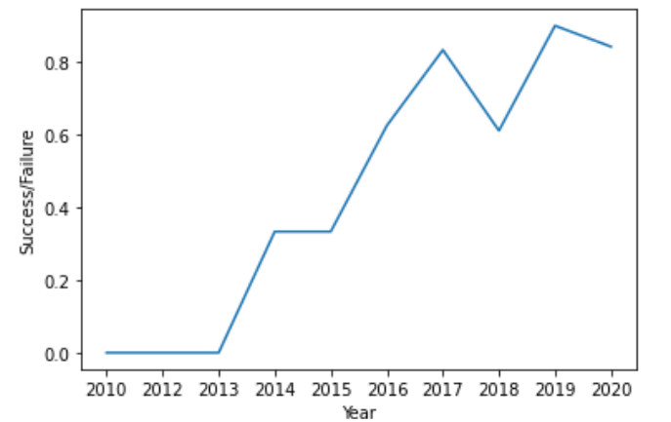
Launch Success Yearly Trend
From the plot, we can observe that success rate since 2013 kept on increasing till 2020.

Slide 19
Getting some insights from the Data Base
We used the key word DISTINCT to show only unique launch sites from the SpaceX data.
Used the query above to display 2 records where launch sites begin with `CCA`
Can calculate the total payload carried by boosters from NASA with the below query.
Can calculate the average payload mass carried by booster version F9 v1.1 using the below query
The date of the first successful landing outcome on ground pad can be fetched using the below query.
Used the WHERE clause to filter for boosters which have successfully landed on drone ship and applied the AND condition to determine successful landing with payload mass greater than 4000 but less than 6000
Used wildcard like ‘%’ to filter for WHERE LANDING__OUTCOME was a success or a failure.
Determined the booster that have carried the maximum payload using a subquery in the WHERE clause and the MAX() function.
Used a combinations of the WHERE clause AND conditions to filter for failed landing outcomes in drone ship, their booster versions, and launch site names for year 2015
We selected Landing outcomes and the COUNT of landing outcomes from the data and used the WHERE clause to filter for landing outcomes BETWEEN 06-04-2010' AND '03-20-2017. • We applied the GROUP BY clause to group the landing outcomes and the ORDER BY clause to order the grouped landing outcome in descending order

Slide 20
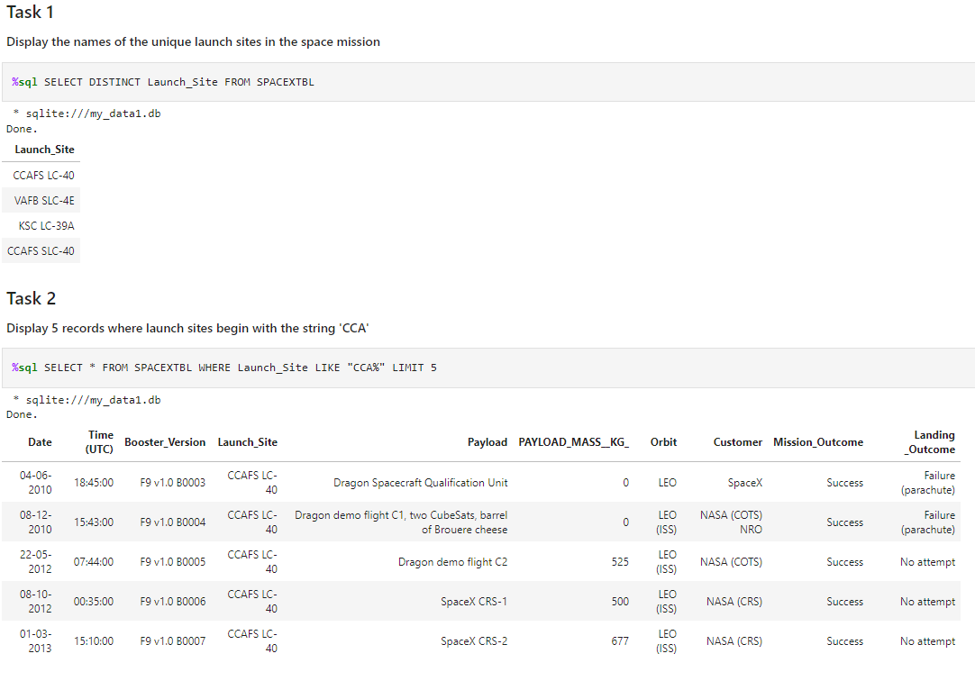
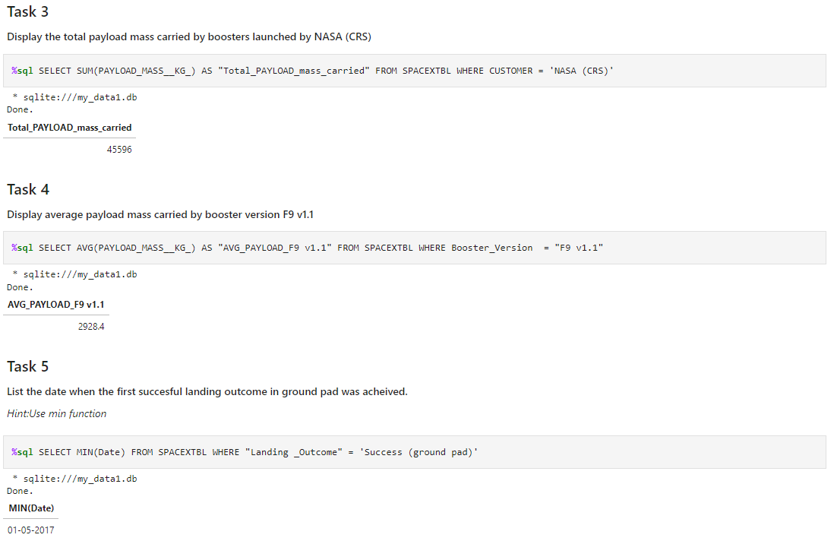

Slide 21
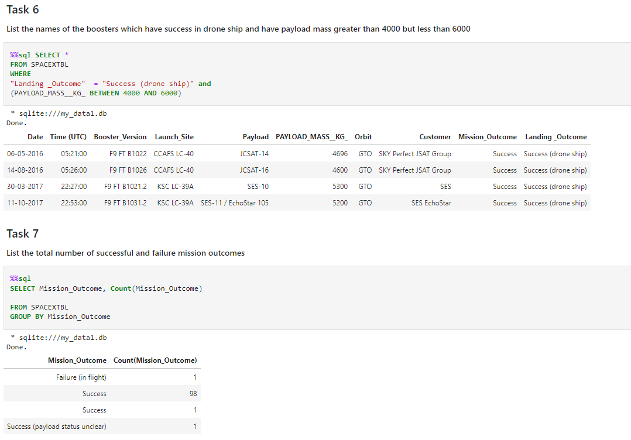
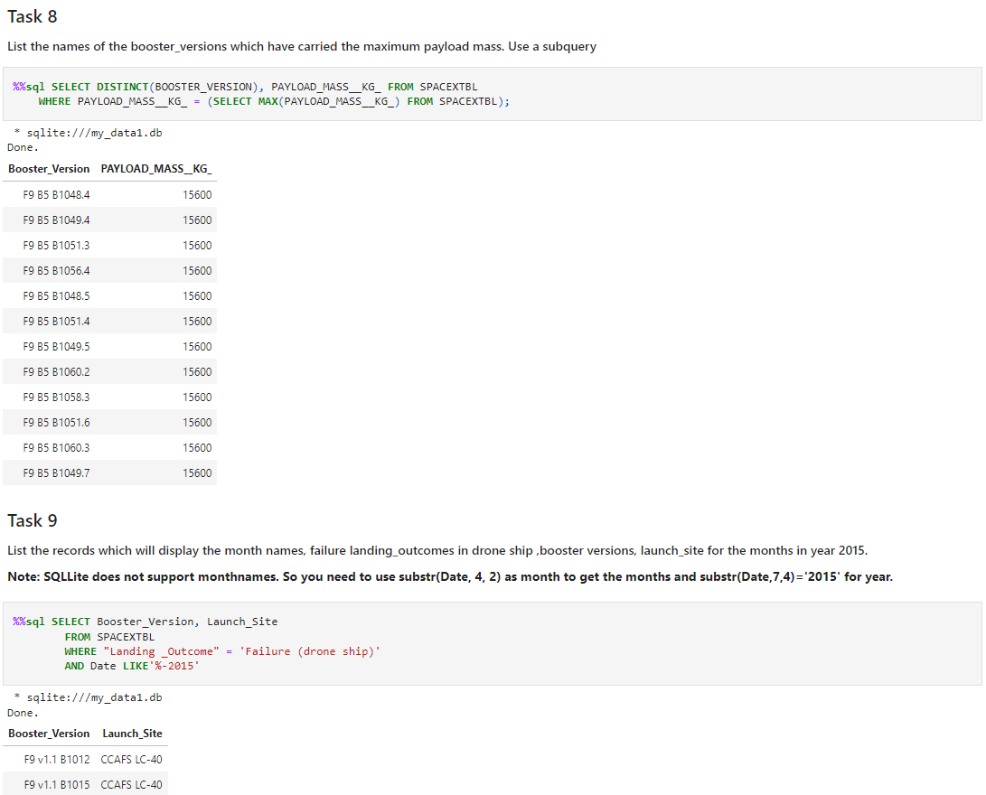

Slide 22
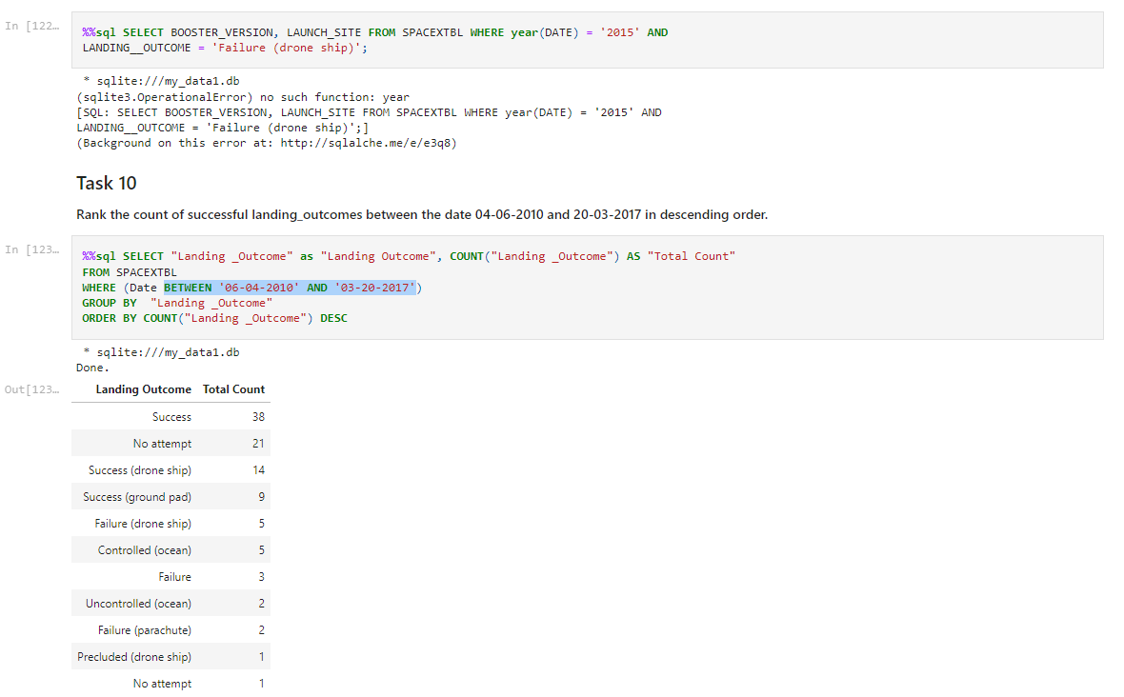

Slide 23
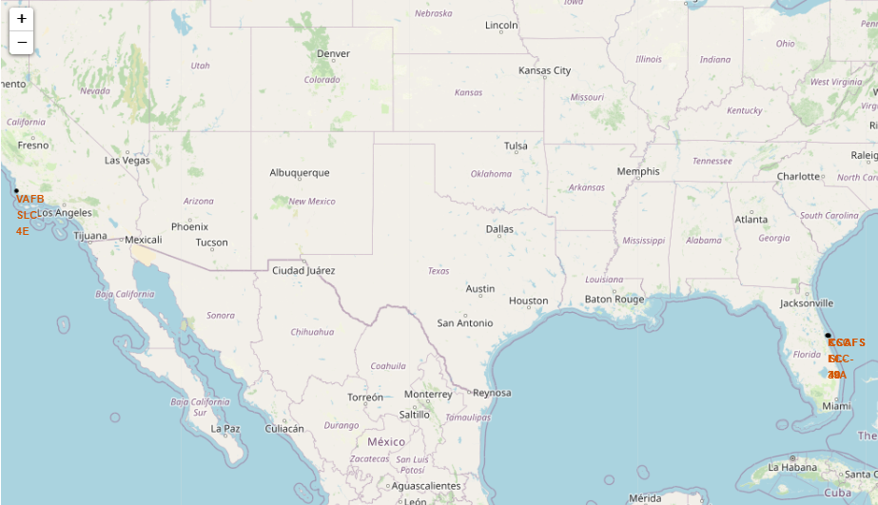
All launch sites on a map

Slide 24
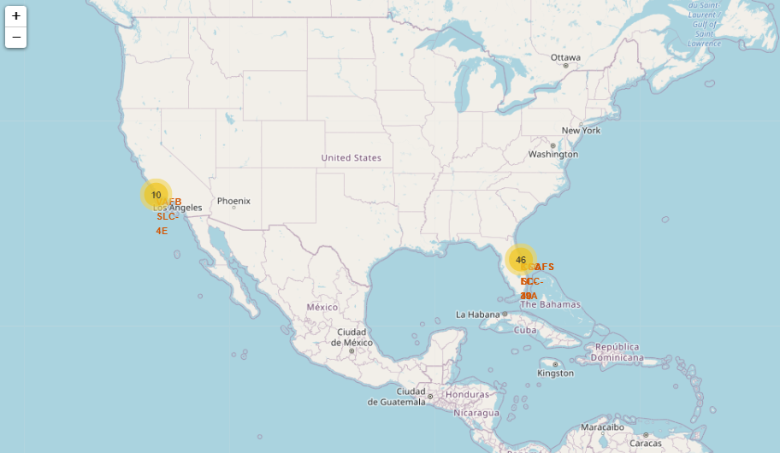
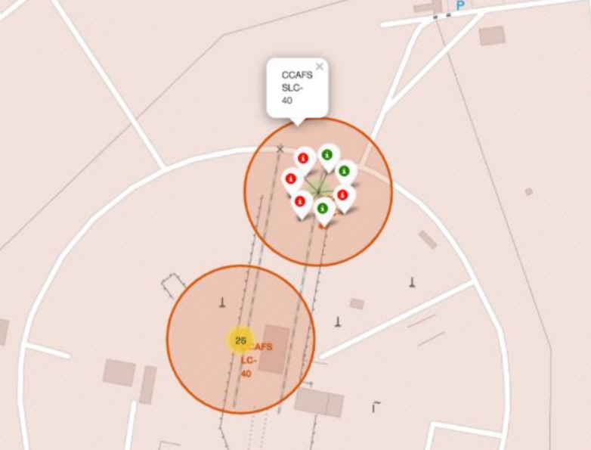
Success/failed launches for each site on the map and Success/failed launches for each site on the map

Slide 25
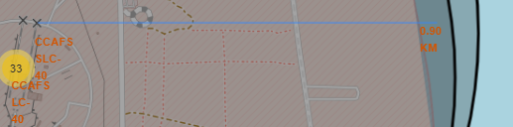
Distances between a launch site to his proximities

Slide 26
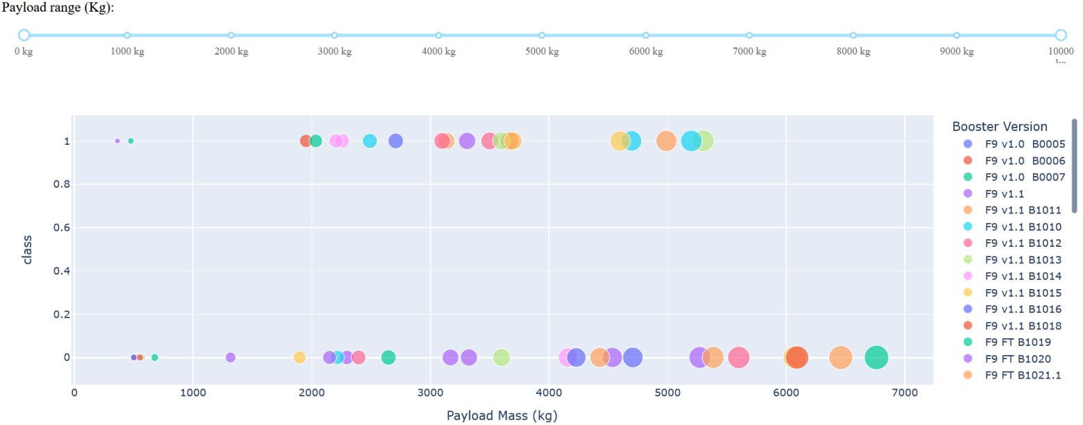
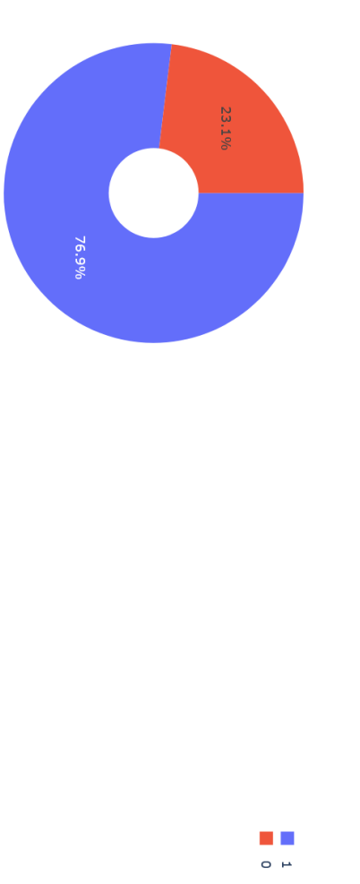
Pie chart showing the Launch site with the highest launch success ratio and Scatter plot of Payload vs Launch Outcome for all sites

Slide 27
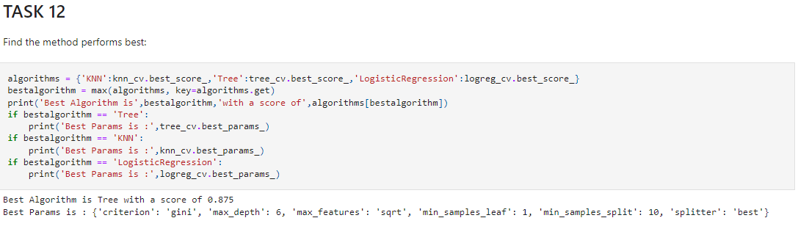
Classification Accuracy
The decision tree classifier is the model with the highest classification accuracy
It gives us a 87% of confidence probably could be improve with more data.

Slide 28
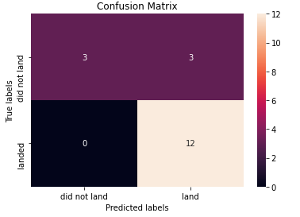
Confusion Matrix
The confusion matrix for the decision tree classifier shows that the classifier can distinguish between the different classes.
The major problem is the false positives. i.e. unsuccessful landing marked as successful landing by the classifier.

Slide 29
Conclusions
It can be concluded that: • The larger the flight amount at a launch site, the greater the success rate at a launch site.
Launch success rate started to increase in 2013 till 2020.
Orbits ES-L1, GEO, HEO, SSO, VLEO had the most success rate.
KSC LC-39A had the most successful launches of any sites.
The Decision tree classifier is the best machine learning algorithm for this task.

Slide 30
…...................Note......................
After This Presentation i will expend more time in improve this but at the moment i got few hours until my subscripcion ends so this is the best i could do with the time i had, i gope you apreciate and enjoy the work, see you soon

